Slide 1
Decred On-Chain Indicators
Format for indicator presentation:
Chart / Indicator Name
Calculation for Indicator

Slide 2
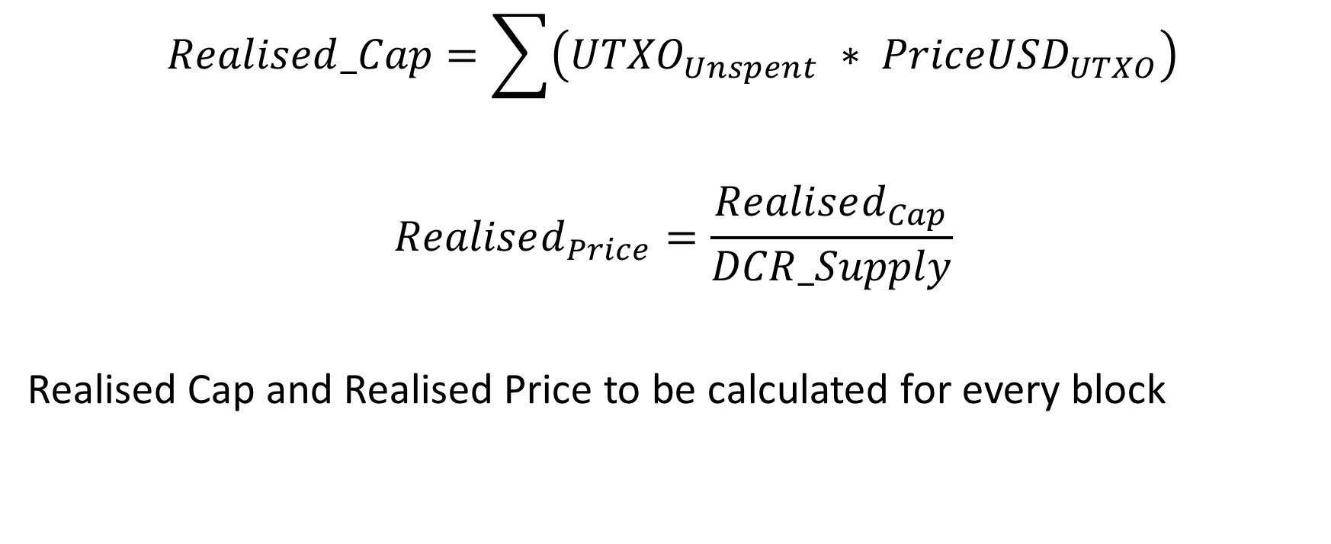
Primitives
$$Realised_Cap=\sum{\left({UTXO}_{Unspent} ∗ {PriceUSD}_{UTXO}\right)}$$
$$Realised_{Price}=\frac{Realised_{Cap}}{DCR_Supply}$$
Realised Cap and Realised Price to be calculated for every block

Slide 3
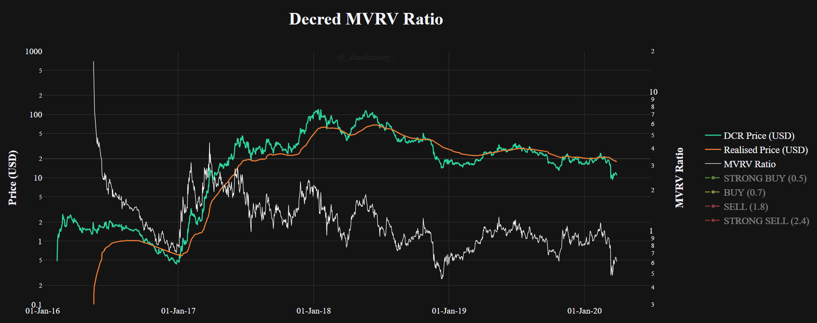
0: MVRV Ratio

Slide 4
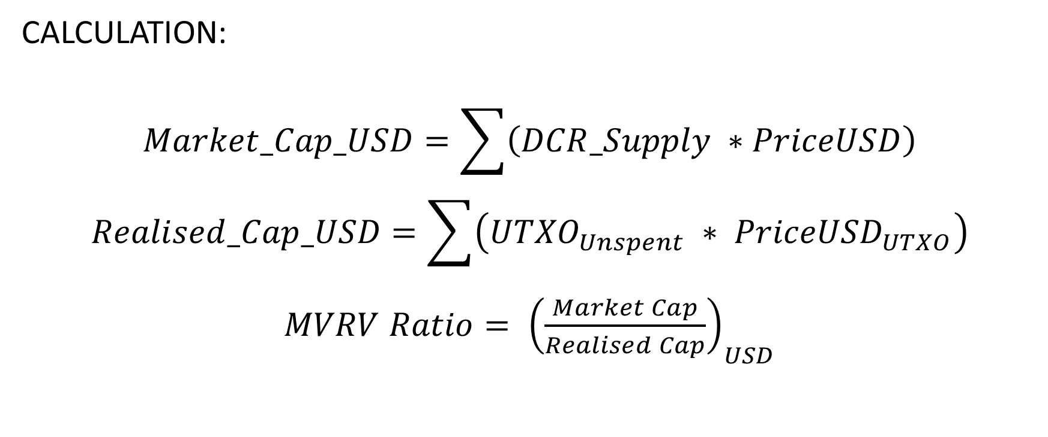
0: MVRV Ratio
CALCULATION:
$$Market_Cap_USD=\sum{\left(DCR_Supply ∗PriceUSD\right)}$$
$$Realised_Cap_USD=\sum{\left({UTXO}_{Unspent} ∗ {PriceUSD}_{UTXO}\right)}$$
$MVRV Ratio= {\left(\frac{Market Cap}{Realised Cap}\right)}_{USD}$

Slide 5
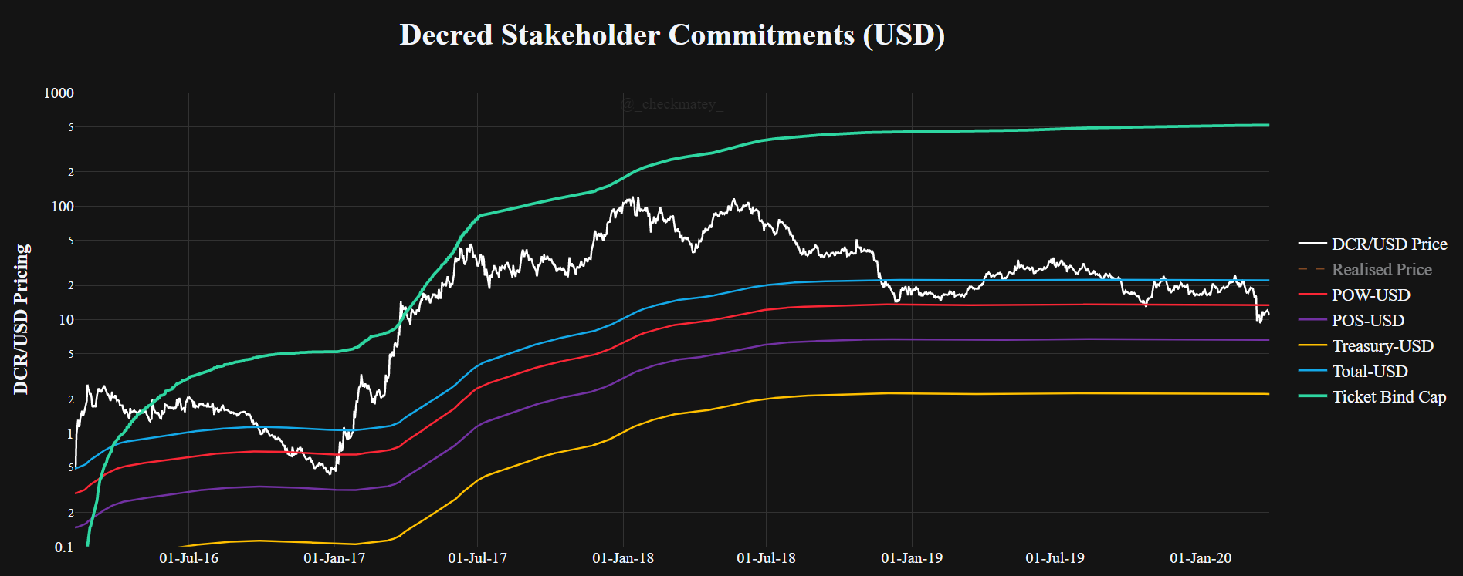
0b: Block Subsidy Model (USD)

Slide 6
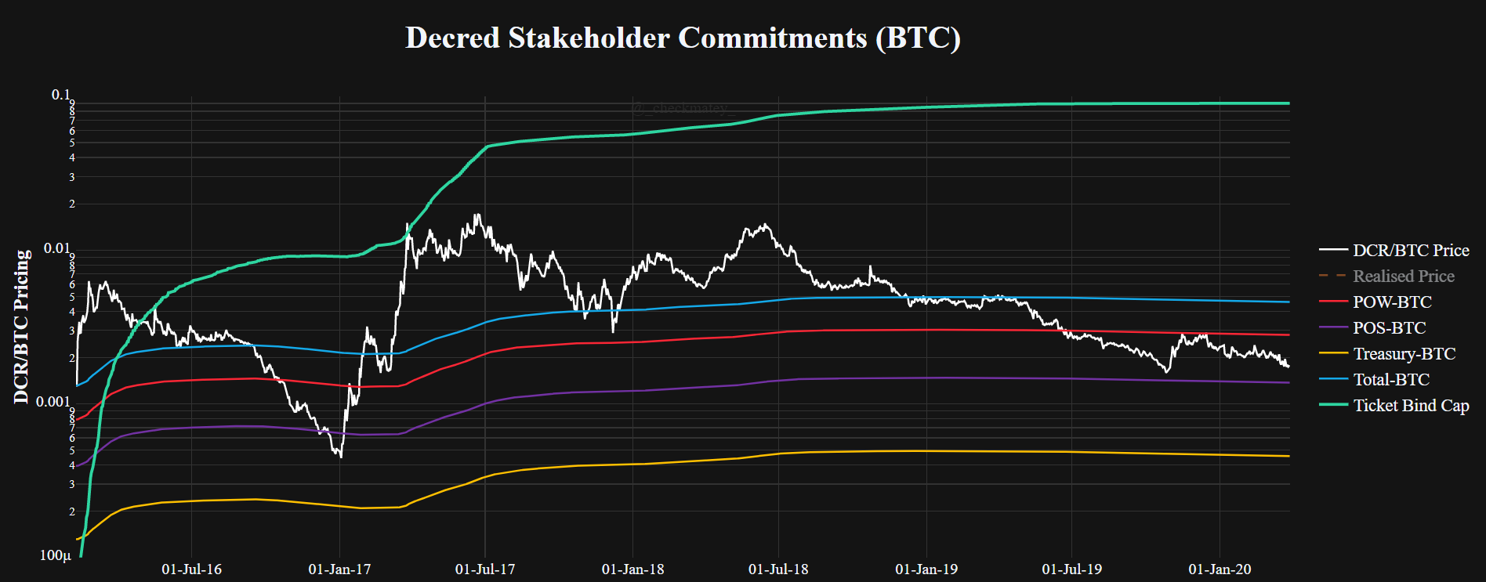
0b: Block Subsidy Model (BTC)

Slide 7
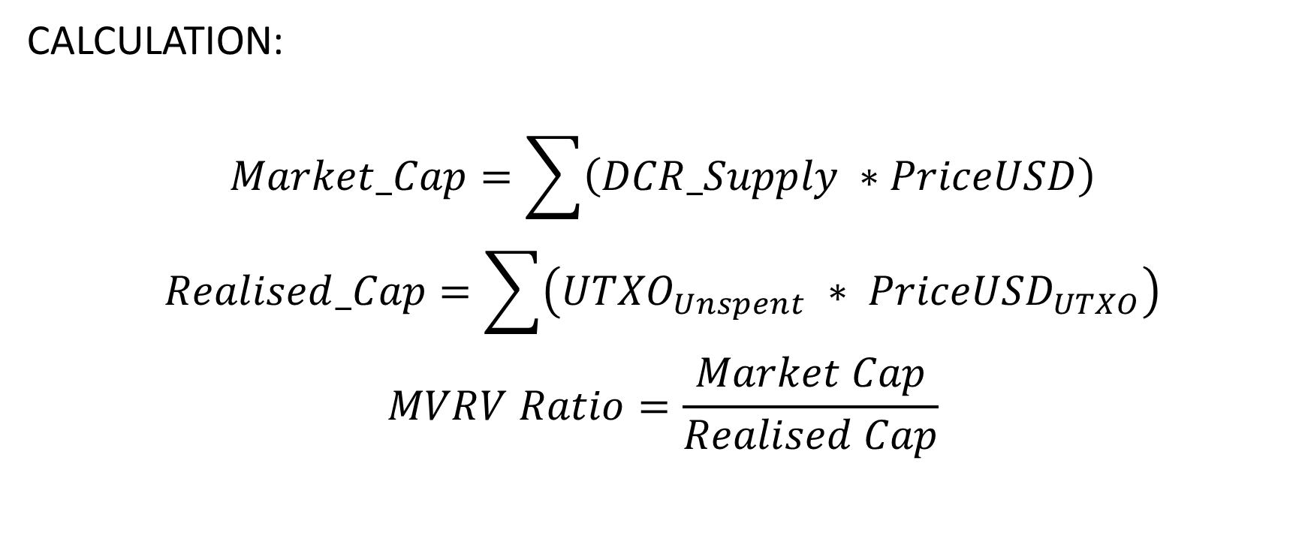
0: MVRV Ratio
CALCULATION:
$$Market_Cap=\sum{\left(DCR_Supply ∗PriceUSD\right)}$$
$$Realised_Cap=\sum{\left({UTXO}_{Unspent} ∗ {PriceUSD}_{UTXO}\right)}$$
$$MVRV Ratio=\frac{Market Cap}{Realised Cap}$$

Slide 8
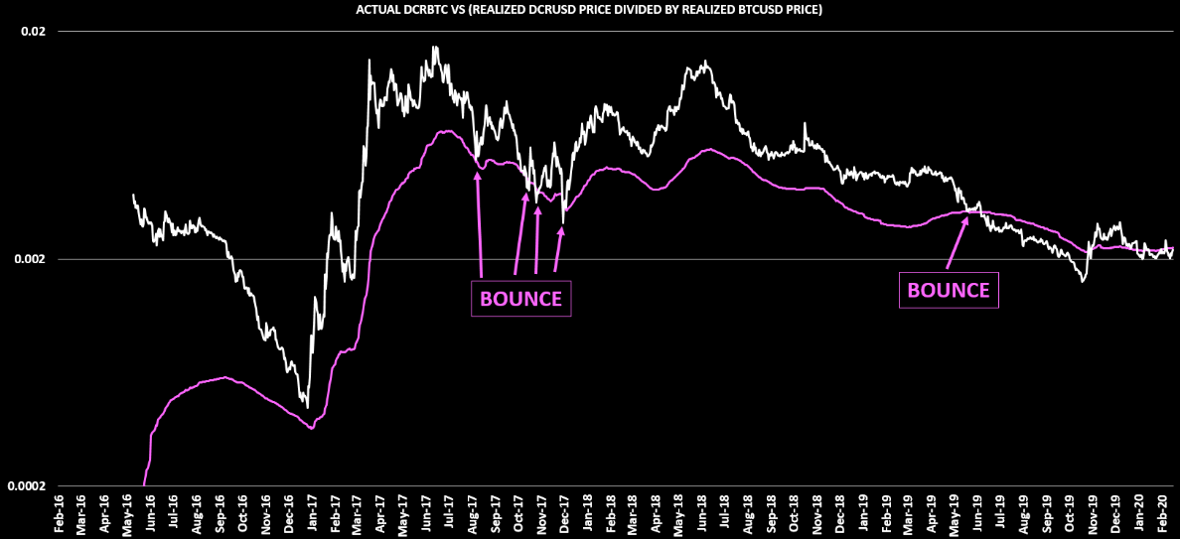
1: ON-CHAIN DCRBTC PRICE

Slide 9
1: ON-CHAIN DCRBTC PRICE
CALCULATION:
DCRUSD REALIZED PRICE
BTCUSD REALIZED PRICE

Slide 10
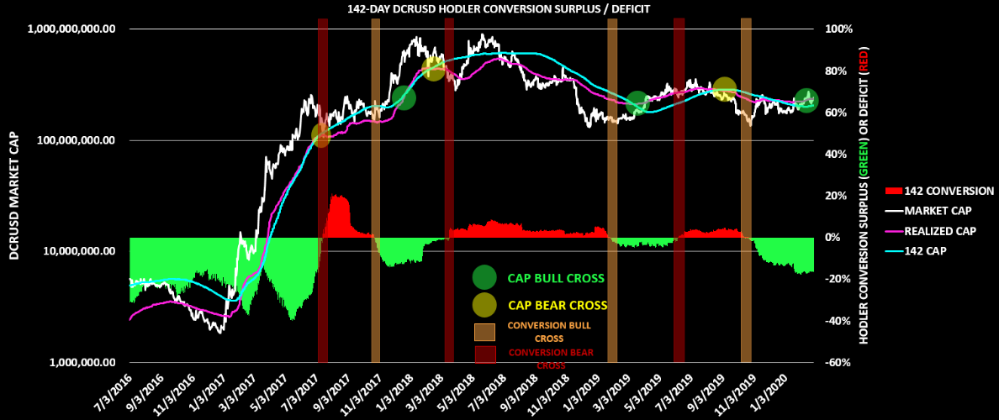
2: 142 DAY HODLER CONVERSION RATE

Slide 11
2: 142 DAY HODLER CONVERSION RATE
CALCULATION:
NOTE: “TOTAL SUM OF DCR MOVED OVER 142 DAYS” ON COINMETRICS = TxTfrValNtv

Slide 12
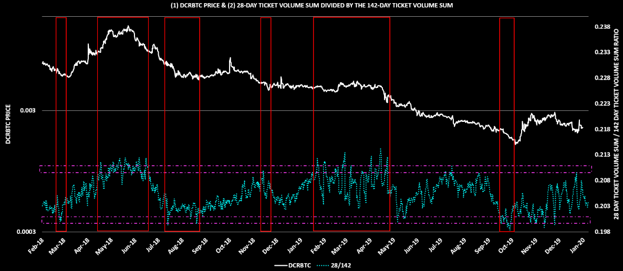
3: OVER / UNDER BOUGHT TICKET MEASURE

Slide 13
3: OVER / UNDER BOUGHT TICKET MEASURE
CALCULATION:
DCR SUM IN TICKETS OVER 28 DAYS
DCR SUM IN TICKETS OVER 142 DAYS

Slide 14
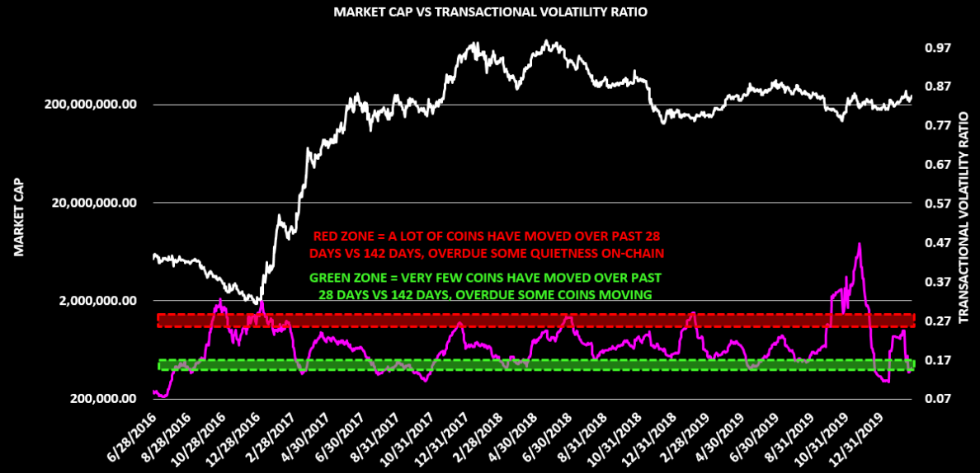
4: TRANSACTIONAL VOLATILITY RATIO

Slide 15
4: TRANSACTIONAL VOLATILITY RATIO
CALCULATION:
SUM OF DCR MOVED IN STANDARD TXS OVER 28 DAYS
SUM OF DCR MOVED IN STANDARD TXS OVER 142 DAYS
NOTE: “SUM OF DCR MOVED” ON COINMETRICS = TxTfrValAdjNtv

Slide 16
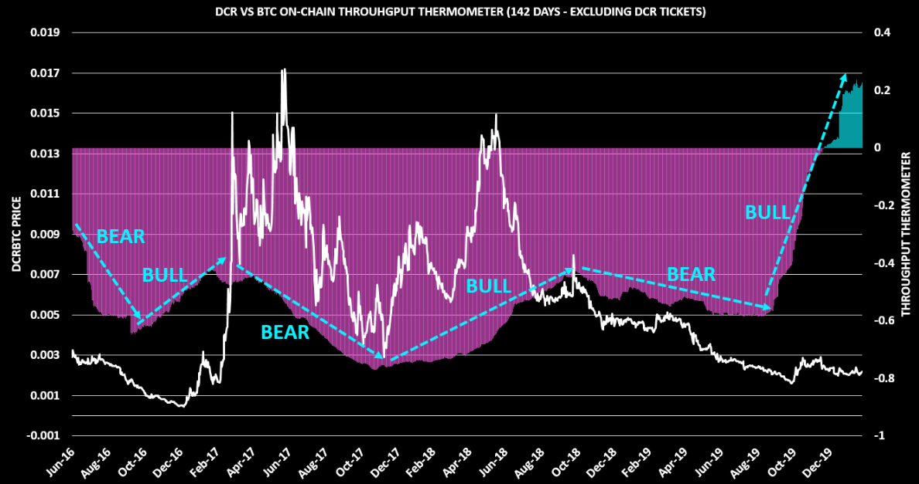
5: ON-CHAIN THROUGHPUT THERMOMETER

Slide 17
5: ON-CHAIN THROUGHPUT THERMOMETER
CALCULATION:
NOTE: COINS MOVED ON COINMETRICS = TxTfrValAdjNtv

Slide 18
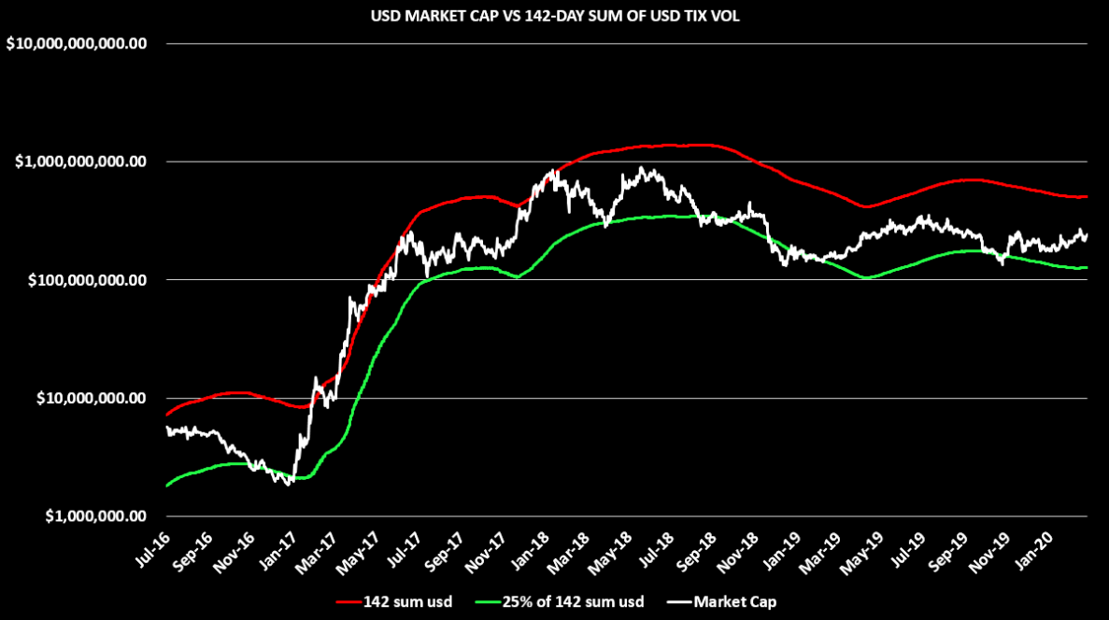
6: 142-DAY TIX VOL SUM

Slide 19
6: 142-DAY TIX VOL SUM
CALCULATION:
RED LINE = 142-DAY SUM OF USD VALUE TICKET VOLUME
GREEN LINE = 25% OF RED LINE

Slide 20
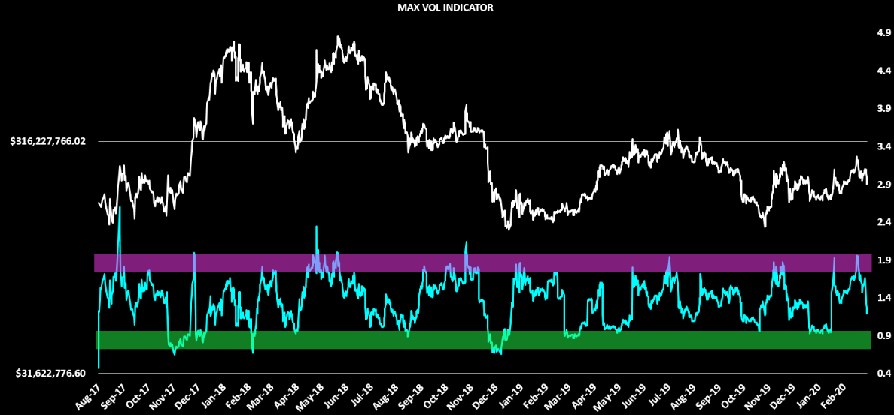
7: MAX VOL RATIO

Slide 21
7: MAX VOL RATIO
CALCULATION:
MARKET CAP
(MAX 288 BLOCK USD SUM IN TIX OVER PAST 28 DAYS) * 28

Slide 22
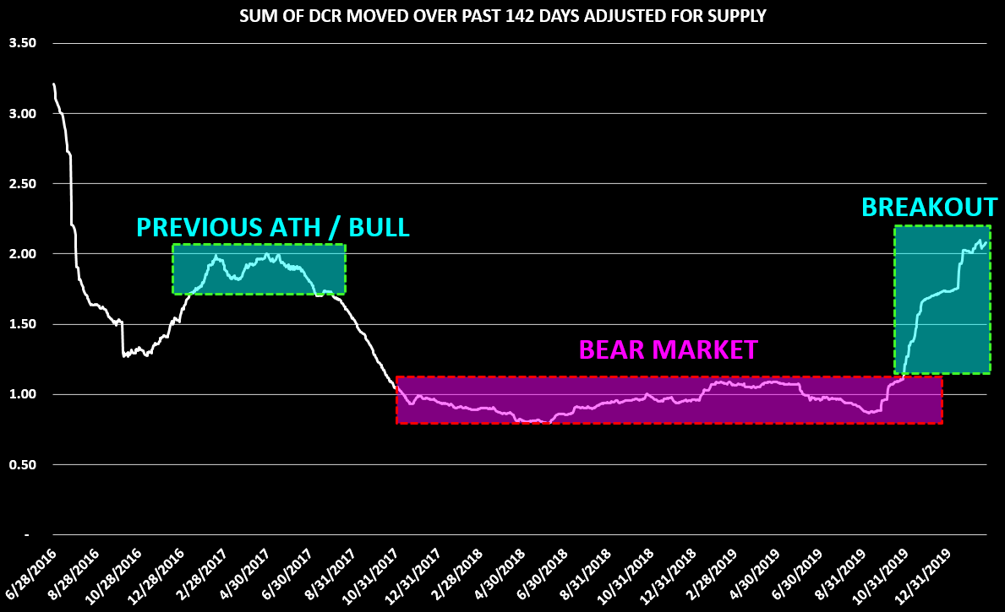
8: 142-DAY MOVED SUM ADJUSTED FOR SUPPLY

Slide 23
8: 142-DAY SUM MOVED ADJUSTED FOR SUPPLY
CALCULATION:
SUM OF DCR MOVED OVER PAST 142 DAYS
CURRENT SUPPLY
NOTE: COINS MOVED ON COINMETRICS = TxTfrValAdjNtv

Slide 24
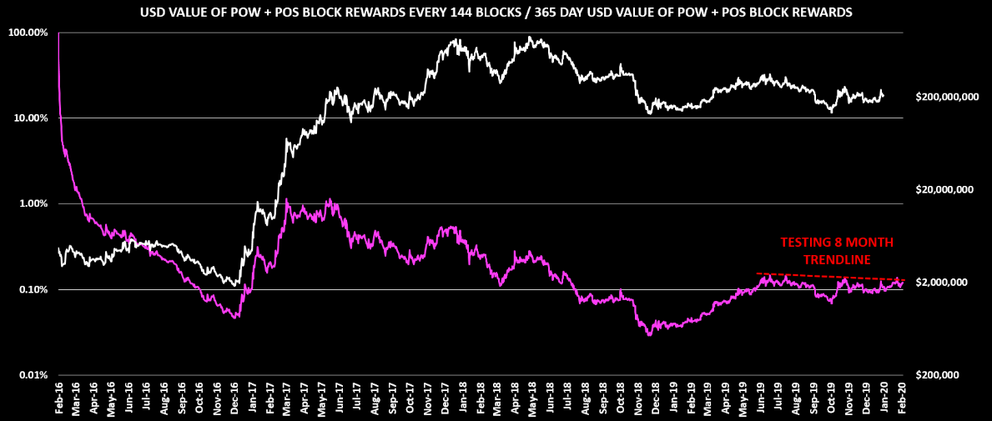
9: SHORT TERM RELATIVE SELLING POWER

Slide 25
9: SHORT TERM RELATIVE SELLING POWER
CALCULATION:
USD BLOCK REWARDS ISSUED IN 144 BLOCK PERIOD
SUM OF USD BLOCK REWARDS ISSUED OVER 365 DAYS

Slide 26
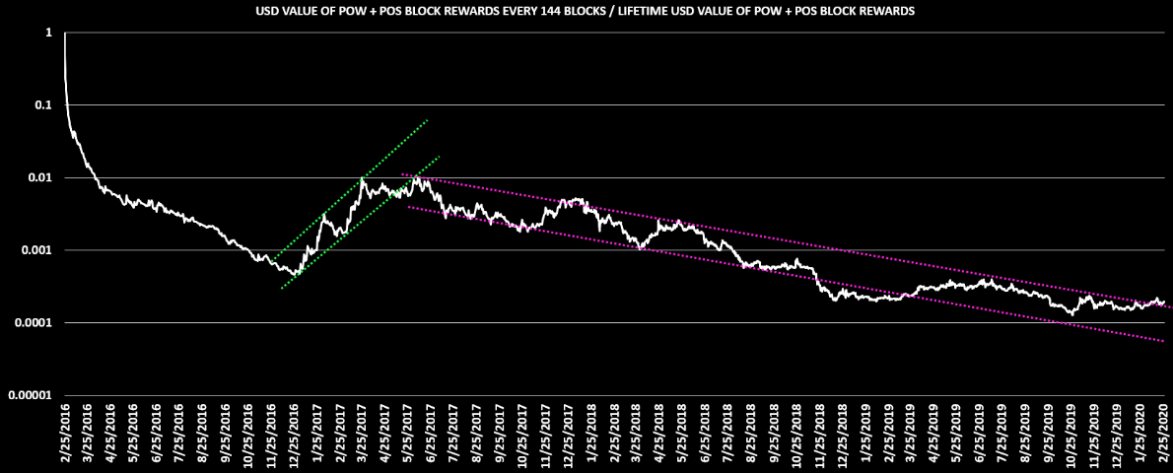
10: LONG TERM RELATIVE SELLING POWER

Slide 27
10: LONG TERM RELATIVE SELLING POWER
CALCULATION:
USD BLOCK REWARDS ISSUED IN 144 BLOCK PERIOD
SUM OF USD BLOCK REWARDS ISSUED OVER LIFETIME

Slide 28
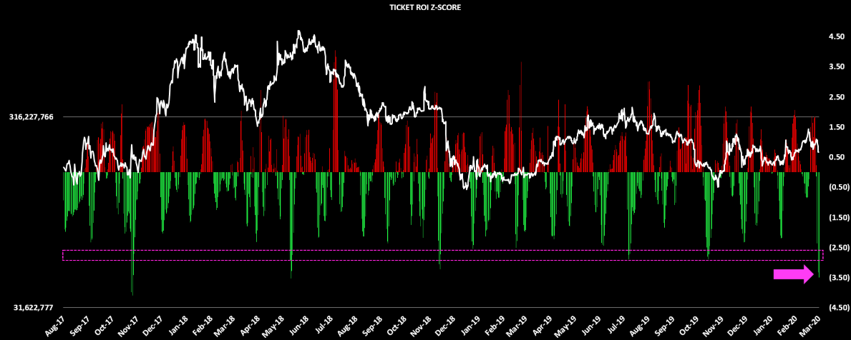
11A: TICKET ROI Z-SCORE

Slide 29
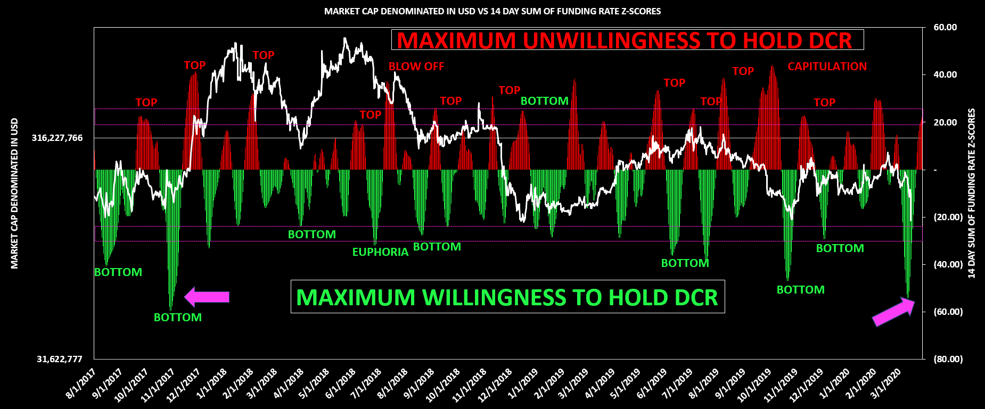
11B: TICKET ROI Z-SCORE (14 DAY SUM)

Slide 30
11A: TICKET ROI Z-SCORE
CALCULATION:
CURRENT ROI – 28 DAY ROI AVG = A
28 DAY AVERAGE(A) = B
28 DAY STANDARD DEVIATION OF A = C
A – B
C
TICKET ROI Z-SCORE = D =

Slide 31
11B: TICKET ROI Z-SCORE (14 DAY SUM)
CALCULATION:
14-DAY SUM OF D FROM PREVIOUS SLIDE

